Slide 1
Renewable energy systems
euroenta

Slide 2



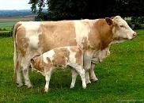


euroenta was established in 2010 as partner company of enta electric a.ş. to provide superior service with respect to renewable energy.
Our aim is to become one of the preferred companies for installation of wind turbines, PV systems and biogas applications. In addition we intend to find suitable energy solutions for each project and provide equipment for renewable energy systems such as invertors and batteries.

Slide 3




Our partner companies are well known with high level of customer satisfaction and reliability for numerous projects on turnkey basis in various areas.
Our priority is to protect and improve this reputation for renewable energy systems.
Our Partner Companies;

Slide 4
"Since 1982, Quality and Trust: at the heart of electricity.”
Specialties:
Renewable energy projects,
Construction,
Electrical systems projects for housing
Electrification of buildings, industrial plants,
Power transmission lines and
Transformer centers
LV-MV urban Networks
Supply of various products for electrical and energy systems.
contact:
Headquarters: PERPA İŞ MERKEZİ B Blok Kat: 2 No: 0004 Okmeydanı İSTANBUL,Şişli 34384 Turkey
Website: http://www.entaelektrik.com.tr/

Slide 5

RENEWABLE ENERGY PROJECTS

Slide 6
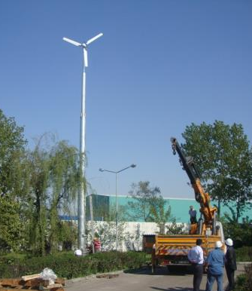
PROJECT NAME: ALMETSAN PLANT
3,5 kW Wind Turbine Installation
Customer : ALMETSAN
Location : Gebze-Türkiye
Start : 10.05.2011
Finish : 15.05.2011
Specifications
Power : 3,5 kW
Length of tower : 16+2 = 18 m
İnverters : 1 (On-Grid)
Annual production: 5550-11300 kWh (5-7 m/s)
Reference Projects

Slide 7
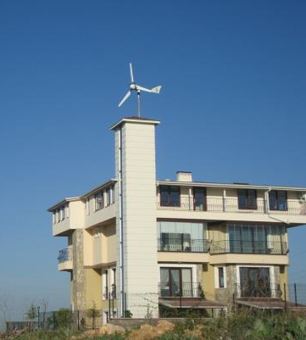
PROJECT NAME: Prof. İlyas Yılmazer Residence
1,5 kW Wind Turbine Installation
Customer : İlyas Yılmazer
Location : Ankara-Türkiye
Start : 20.05.2011
Finish : 22.05.2011
Specifications
Power : 1,5 kW
Length of tower : 4 m
İnverters : 1 (On-Grid)
Annual production: 2400-4850 kWh (5-7 m/s)
Reference Projects

Slide 8
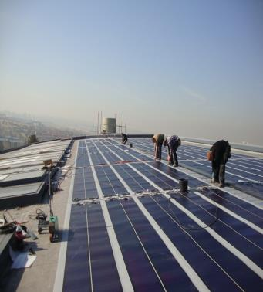
PROJECT NAME: METU Ayaslı research Department Roof-integrated PV System
Customer : METU Electrical and Electronics Department
Location : Ankara-Türkiye
Start : 01.10.2011
Finish :31.12.2011
Specifications
Power : 51,40 kWp
Area : 712 m2 membrane + 40 m2 window
Inverters : 10 (On-Grid)
9x3 Phase + 1x Single Phase
*Thin-film Membrane with TPO roofing system
*Translucent membranes are used for rooflight
Reference Projects

Slide 9
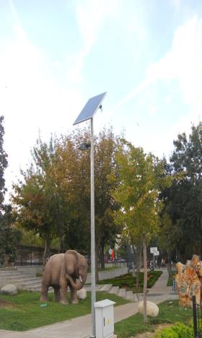
PROJECT NAME: Bakırköy Municipality – Solar street light
Customer : Bakırköy Municipality
Location : Istanbul-Türkiye
Start : 12.09.2012
Finish : 12.09.2012
Specifications
*Off-Grid – Solar Led Street Light
(Experimental application)
Reference Projects

Slide 10
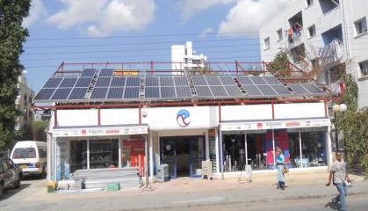
PROJECT NAME: ERTEK Elektric
Lefkoşa(Nicosia) main office PV system Installation
Customer : Ertek
Location :Nicosia/Northern Cyprus
Start : 04.10.2012
Finish : 05.10.2012
Specifications
Power : 6 kWp
Inverters : 1 (On-Grid)
Estimated annual production: 10000 kWh
* Monocrystalline solar panels are used.
Reference Projects

Slide 11
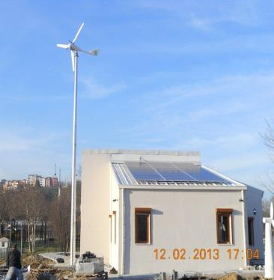
PROJECT NAME: Eyüp Municipality – Green Building Solar and Wind System
Customer : Eyüp Municipality
Location : Istanbul-Türkiye
Start : 20.12.2012
Finish : 10.02.2012
Specifications
*PV system: : 5760 Wp (On-Grid)
*Wind system: 1,5 kW (On-Grid)
Reference Projects

Slide 12
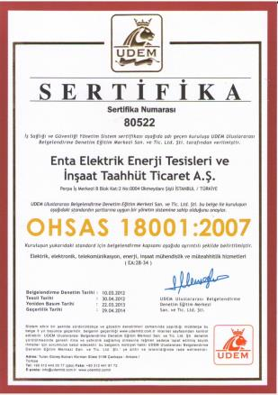


Our Certificates

Slide 13

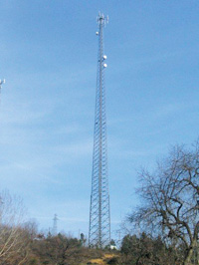

Temitaş Co.Inc., one of Cenay Group's domestic associated companies was established in the year of 1989.
Specialties
Telecommunications
Gsm base stations
L.V + m.V city networks energy transfer lines transformer stations
Project-consulting and contracting services on turnkey basis
http://www.cenay.com.tr/en/index_t.html
contact:
Headquarters: PERPA İŞ MERKEZİ B Blok Kat: 2 No: 0004 Okmeydanı İSTANBUL,Şişli 34384 Turkey
Website: http://www.temitas.com.tr/

Slide 14

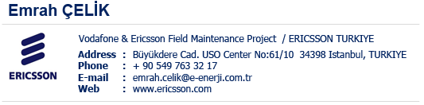






Our Customers

Slide 15
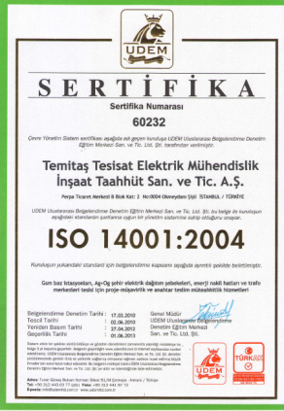


Our Certificates

Slide 16
EUROENTA EXECUTIVE TEAM:
Turgut Okkaya
    Email: turgut.okkaya@euroenta.com
Zafer Taşkın
Email: zafer.taskin@euroenta.com
Yeksun Terzioğlu
Email: yeksun.terzioglu@euroenta.com
contact:
Headquarters : PERPA İŞ MERKEZİ B Blok Kat: 2 No: 0004 Okmeydanı İSTANBUL,Şişli 34384 Turkey
Website : http://www.euroenta.com
Email :info@euroenta.com

